Slide 1
Day 2
Regression Problem
Notes:
Regresyon nedir neden kurarız

Slide 2
What Will We Learn Today?
We will learn what is Regression problem in Machine Learning
We will learn about the kinds of models that can be developed to solve the regression problem.
We will learn the concept of error and its metrics in our regression model
We will learn to measure and improve performance in our regression model.
We will develop a Regression model using the iris dataset
Notes:
Konuşma diline yakın ver örneğin makine öğrenmesi modelinizdeki hatayı düşürmek daha iyi seviyeye getirmek gibi
Maddeli anlatma paragrafta anlat

Slide 3
What is Regression?
Regression determines the relationship between one dependent variable and one or more independent variables.
If the value predicted by the model is a continuous value, this type of problem is a Regression problem.
There are 3 different types of Regression according to the definition of the problem.
Notes:
daHA FAZLA BİLGİ İÇERSİN

Slide 4
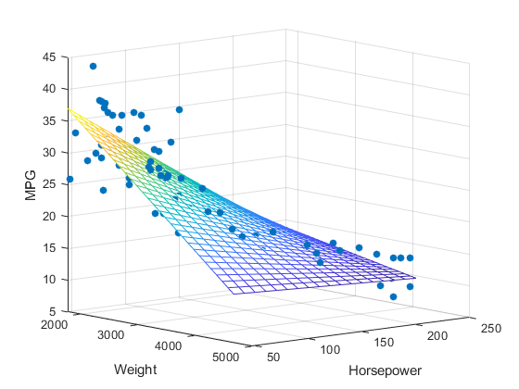
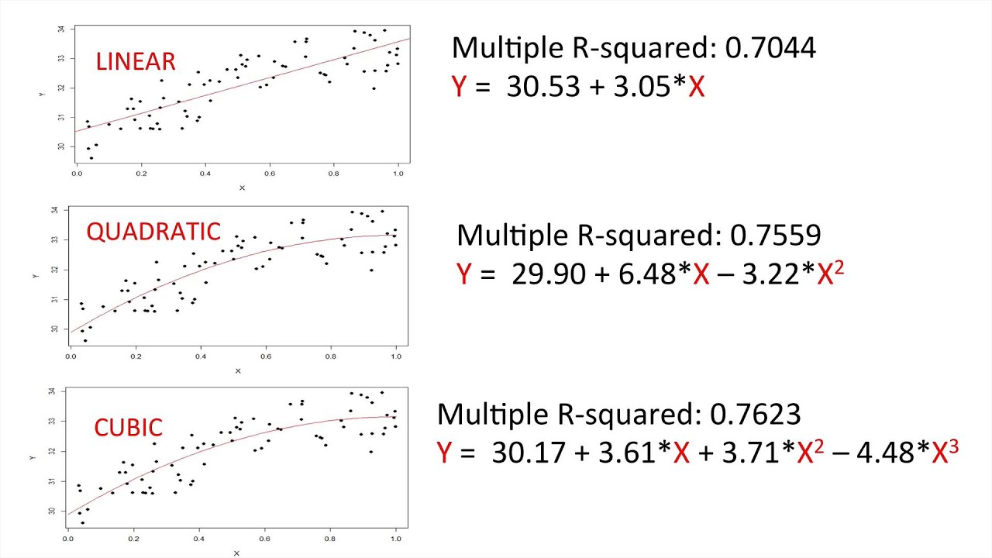
Regression Types
Simple Linear Regression: Regression type used when there is only one independent variable.
Multiple Linear Regression: It is a type of Regression used when there is more than one independent variable.
Polynomial Regression: It is a type of Regression in which the relationship between the independent variable x and the dependent variable y is modeled as an nth order polynomial in x.
Notes:
Boşluklar ekle göz yoruyor

Slide 5
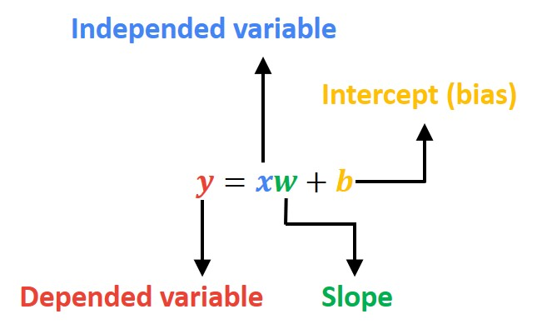

Basic Linear Regression
Simple Linear Regression uses an optimal straight line (also known as a regression line) to establish a relationship between a dependent variable (Y) and an independent variable (X).
Regression tries to find the most optimal line equation that will try to fit all points.
Notes:
Regresyon, tüm noktalara en yakın çizgiyi çizmeye çalışır

Slide 6
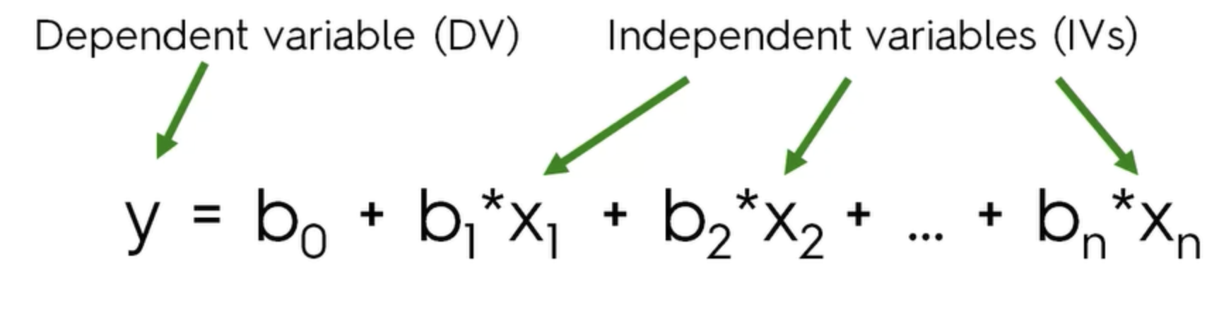
Multiple Linear Regression
Multiple Linear Regression uses an optimal straight line (also known as a regression line) to establish a relationship between the dependent variable (Y) and more than one independent variable (X).
Notes:
Bağımlı değişken label

Slide 7
Polynomial Regression
Polynomial Regression is a form of regression analysis in which the relationship between one or more independent variable x and dependent variable y is modeled as an nth order polynomial in x.
In cases where our simple and multiple linear regression models fail to predict (when our data is nonlinear), we can better fit our model to our data with the help of polynomial regression. For this, we need to give the features we give to the model in degrees (exponential).
Notes:
Neden kullanıyoruz

Slide 8
Measuring the Performance of the Regression Model

Slide 9
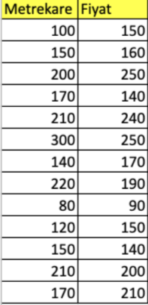
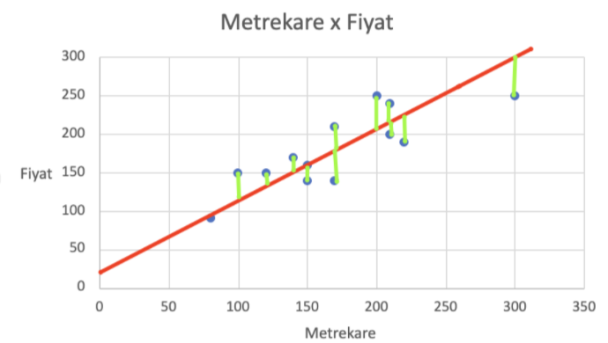
Error Concept
In our regression model, the error is the distance between the true value of the data and its predicted value. Our goal is to minimize this distance for each of our data points.
Since negative errors and positive errors cancel each other out, we use certain statistical equations to calculate the error instead of doing standard addition.

Slide 10
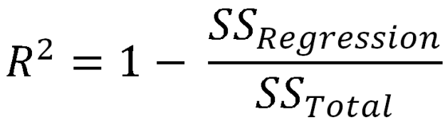
R-squared (R²)
R² is a statistical measure of how close the data are to the fitted regression line. That is, it is a measure of fitness for linear regression models.
✯ A high R² value does not always mean the model is good. In case of overfitting, our R² score will be high.
Notes:
.score yap modeli öncesinde fit et lineer regresyonda colabte

Slide 11
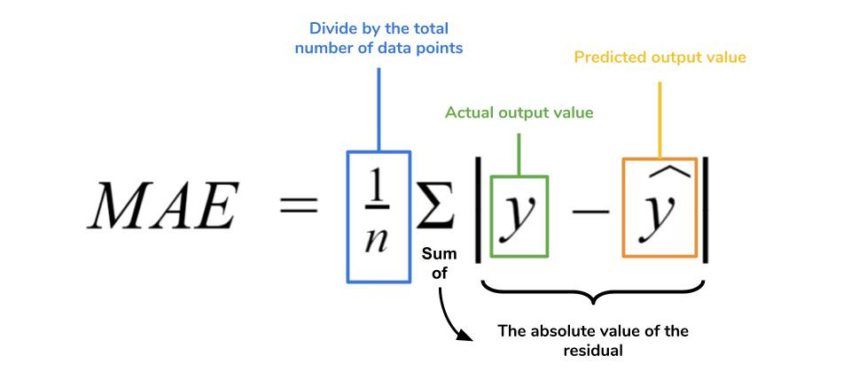
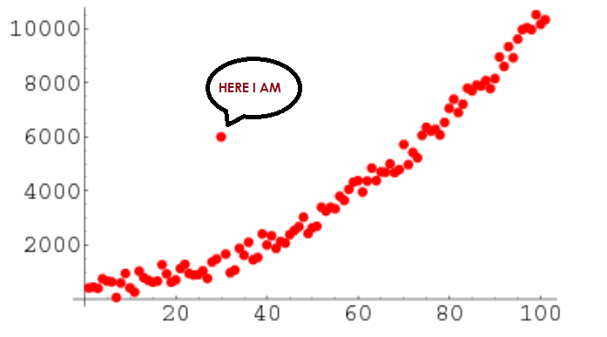
Mean Absolute Error (MAE)
The MAE is the mean of the absolute values of the differences between the predicted values and the actual values.The MAE method has the advantage of not being overly affected by outliers in the training data. A model trained with the MAE approach will give equal importance to 1 error of 5 units and 5 errors of 1 unit.
The main problem with MAE is that it is not at least differentiable. This lack of differentiability can produce convergence problems when training machine learning models.
Notes:
Güzel örnek bul türevlenebilirlik olması açısından

Slide 12
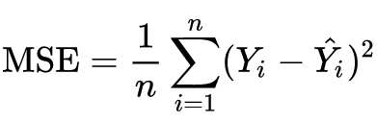
Mean Squared Error (MSE)
MSE is the most commonly used regression error function. Because of the squaring process, large errors (the difference between the actual value and the predicted value) have a greater impact on the MSE than small errors. It's really useful when you want to see if outliers are overly affecting your estimates.
The MSE function is widely used because it is simple, continuous, and differentiable.
An MSE-trained model will give the same importance to a single 5-unit error versus 25 1-unit errors. The model will be biased to reduce the largest errors

Slide 13
Mean Squared Error (MSE)
The mean square error function is widely used because it is simple, continuous, and differentiable.
An important MSE feature is its disproportionate sensitivity to large errors compared to small errors. An MSE-trained model will give the same importance to a single 5-unit error versus 25 1-unit errors. In other words, even if it penalizes the predictions of many common conditions, the model will be biased to reduce the largest errors.

Slide 14
Errors Encountered in Model Training
Underfitting & Overfitting
Notes:
Hepsi capitalize olarak yazılmasın -- DONE

Slide 15
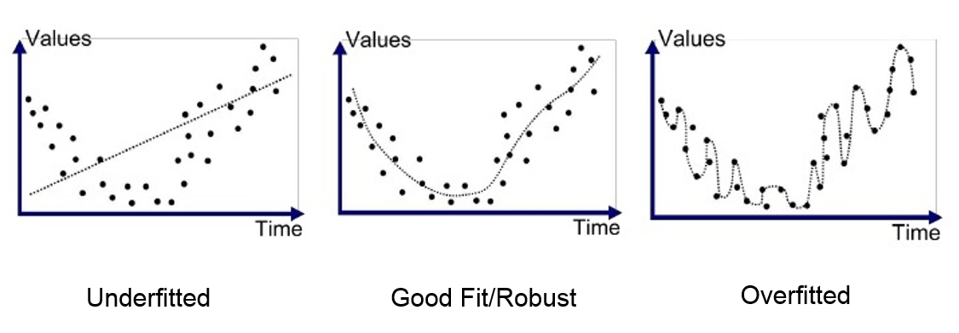
Underfitting & Overfitting
Underfitting
It is a problem that arises when the Machine Learning model fails to catch the trend of our data. In other words, our model does not learn enough from the data or does not extract enough meaning from the data.
Overfitting
It is a problem that arises when the Machine Learning model catches the trend of our data more than it should. In other words, our model memorizes the data we give it rather than learning it and cannot make a successful inference on data it has not seen before.

Slide 16
Underfitting & Overfitting
An important theoretical consequence of Statistics and Machine Learning is that the generalization (ability to make predictions using data it does not see) error of a model can be expressed as the sum of three very different errors:
Bias
Variance
Irreducible Errors
High bias means less variance, which is an example of underfit.
High variance means less bias, which is an example of overfit.
Irreducible errors are related to noise in the data and the only way to fix it is to clean the data
✯ An underfit model has low variance and high bias values.
✯ An overfit model has high variance and low bias.

